Slide 1
Lunar Impact Flash Observations in Turkey
${Mert ACAR}^{1,2}$, $M. {Serdar EVREN}^{1}$
¹Department of Astronomy and Space Sciences, Ege University, İzmir, Turkey
²İSTEK Belde Observatory, İstanbul, Turkey

Slide 2
Lunar Impact Flashes
$$E_{K}=E_{r}/η$$

Slide 3
Impact Events / indirect evidence
Siesmic Data (Nunn et al., 2020).
Lunar Sodium Atmosphere. (Hunten et al., 1998; Verani et al., 1998).

Slide 4
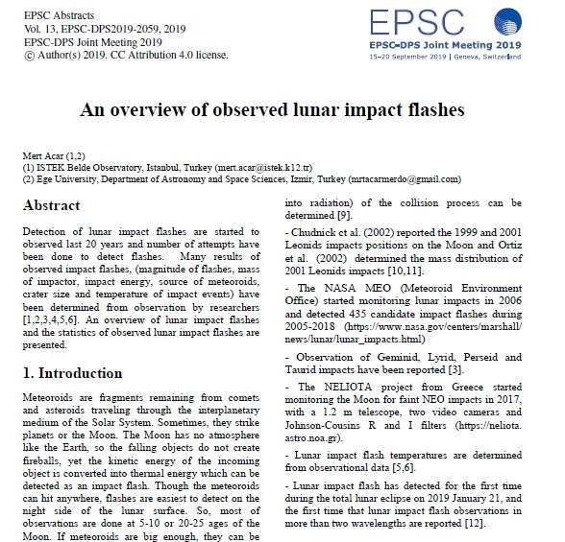
Lunar Impact Flashes
(Melosh et al., 1993)
“a theoretical assessment of impact flash detection by using photometers. ”
(Ortiz et al., 1997)
“CCD cameras instead of photometers.”
(Dunham et al., 2000) ve (Ortiz et al.,2000)
“During the 1999 Leonid meteor showers, two independent groups detected an impact flash on the Moon”
2005 - …….. / NASA MEO
2017 - 2023 / ESA NELIOTA

Slide 5
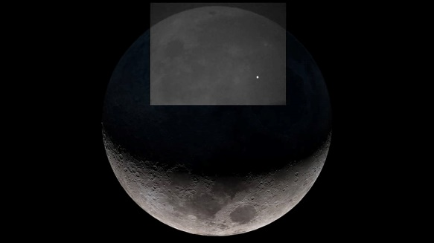
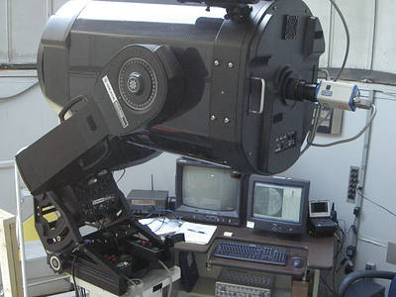
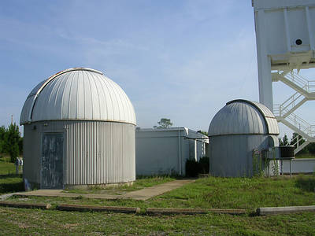
NASA MEO
(Meteoroid Enviroment Office (2005))
443 flashes

Slide 6
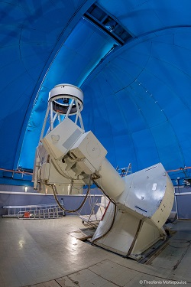
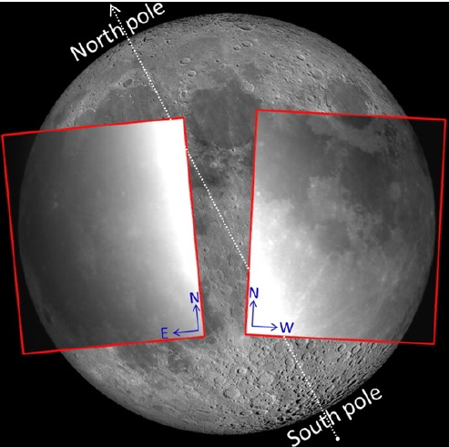
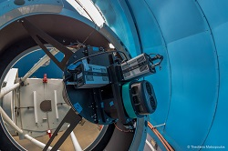
NELIOTA (ESA) (NEO Lunar Impacts and Optical TrAnsients)
1,2 m Kryoneri Telescope
Rc (641 nm), Ic (798 nm) filters
187 flashes

Slide 7
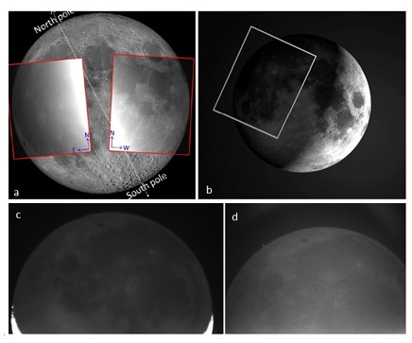
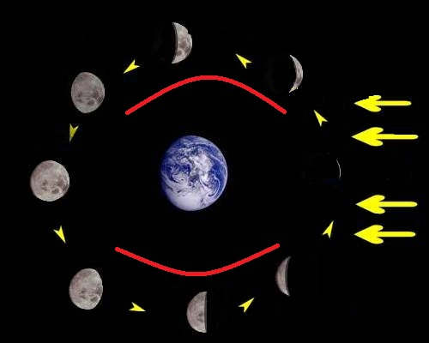
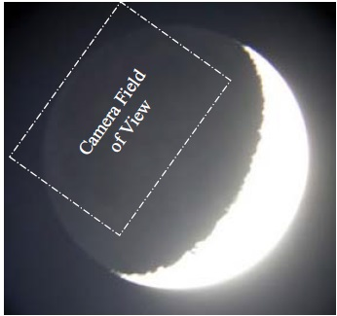
Methods
Video observation
[Suggs, 2008, NASA MEO]
[a) NELIOTA, c,d) İSTEK Belde Observatory]

Slide 8
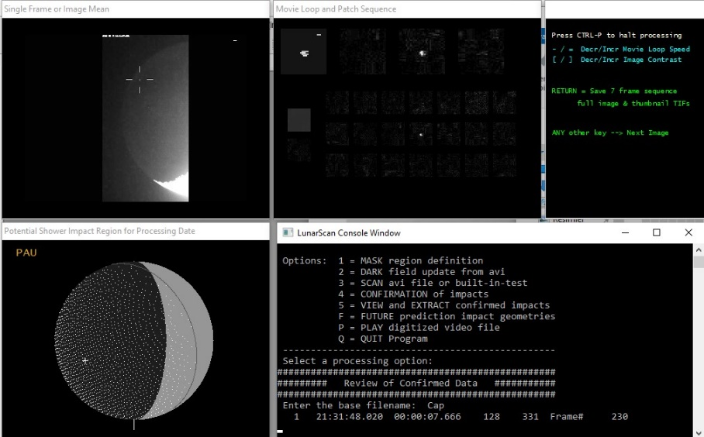
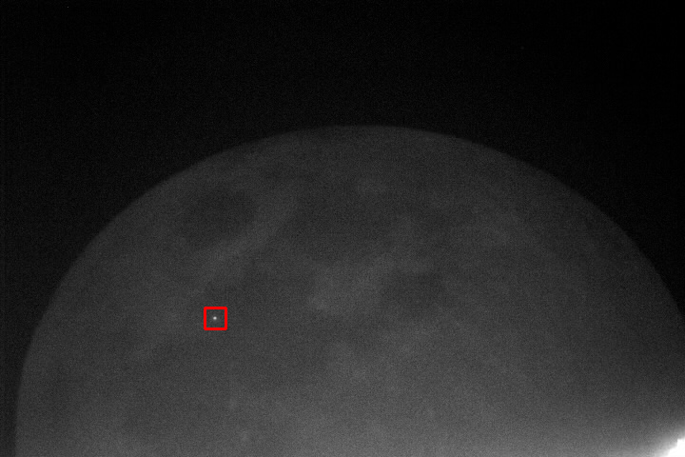
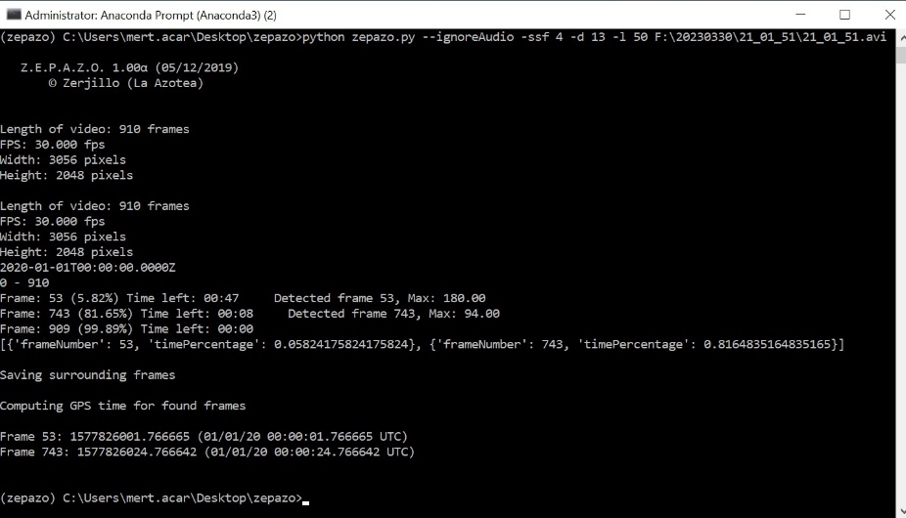
Methods / Softwares
- LUNARSCAN
(Gural, 2007)
- MIDAS (Moon Impact Detection and Analysis System)
(Madiedo et al., 2015)
- FDS (Flash Detection Software)
(ESA, 2022)
- ZEPAZO
(Alonso, UGR, 2018-19)

Slide 9
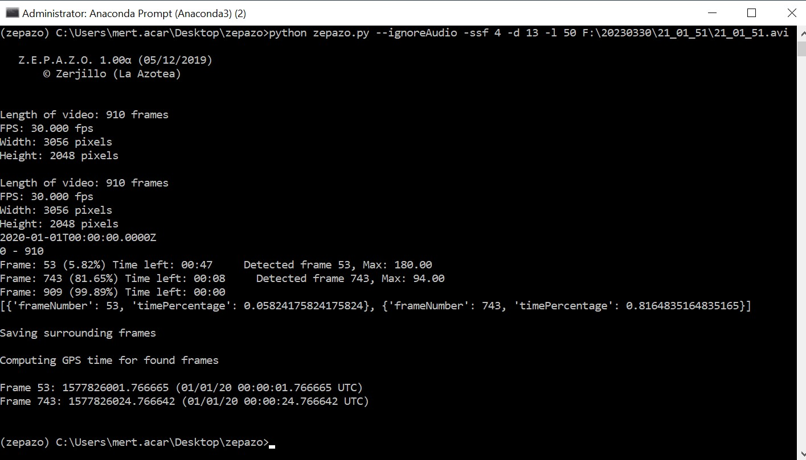
Methods / Analysis

Slide 10
Methods / Analysis

Slide 11
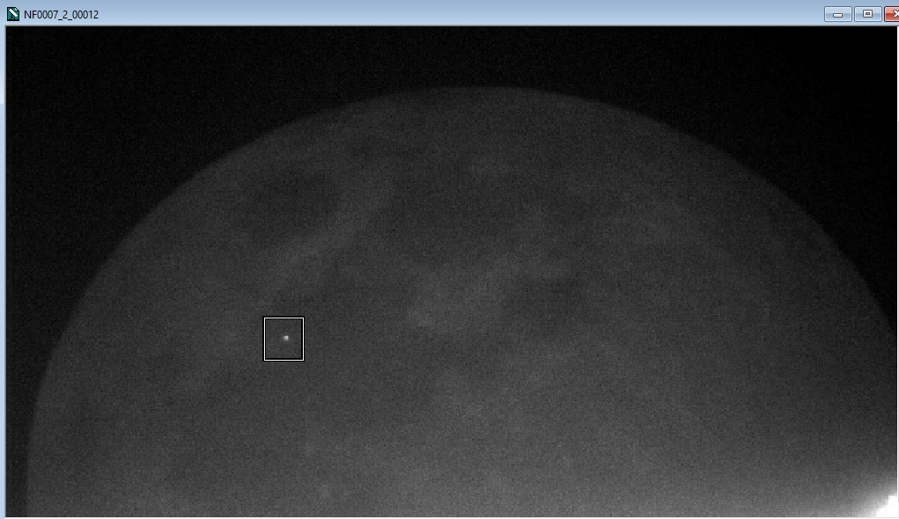
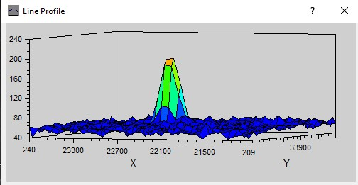
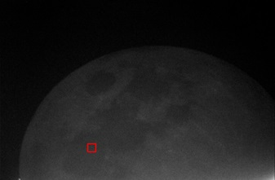
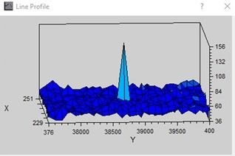
Methods / Analysis

Slide 12
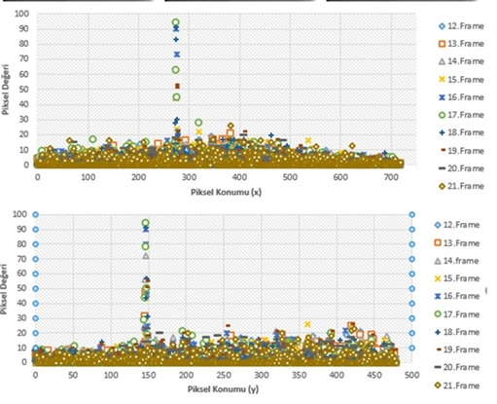
Methods / Analysis

Slide 13
Methods / Analysis
c
c
c
c

Slide 14
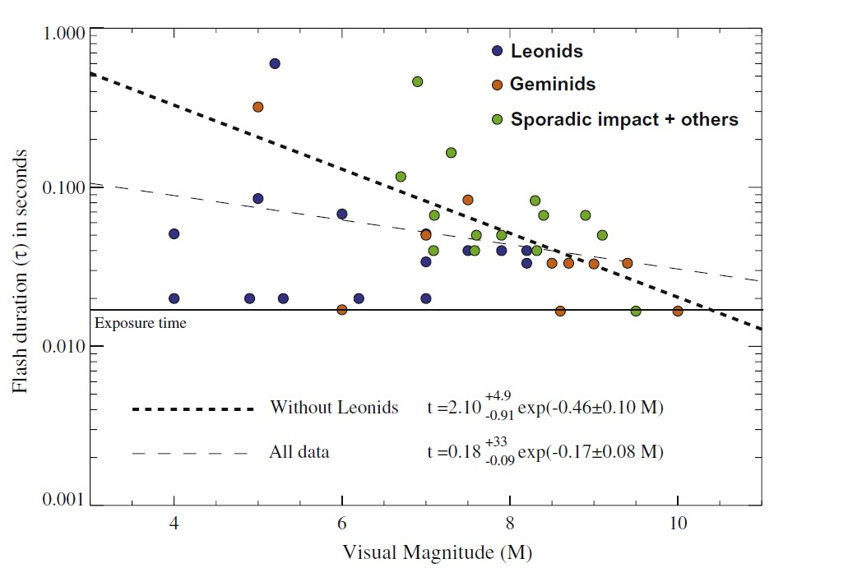
Methods / Analysis
(Bouley et al., 2012)

Slide 15
Radiated Energy
$$E_{r}=E_{d}πfR^{2}$$
$$E_{r}= f_{V}ΔλΔt πfR^{2}$$
Radiated energy on The Moon: $E_{r}$
Observed energy from Earth: $E_{d}$ (numerical integration of the radiated power P with respect to time).
Earth-Moon Distance: $R$
Dimensionless factor that describes the degree of anisotropy of light emission: $f$
Flux density in given bandwidth: $f_{V}$
Duration time: $Δt$
$P=қ ×{10}^{−m/2,5}Δλ$
Radiated Power: $P$
The flux density for a magnitude 0 source : $қ$
(Bessel et al., 1998)
Visual magnitude: $m$
The width of filter passband: $Δλ$
(Madiedo et al., 2019)
(Madiedo et al., 2019)
(Suggs et al., 2014)

Slide 16
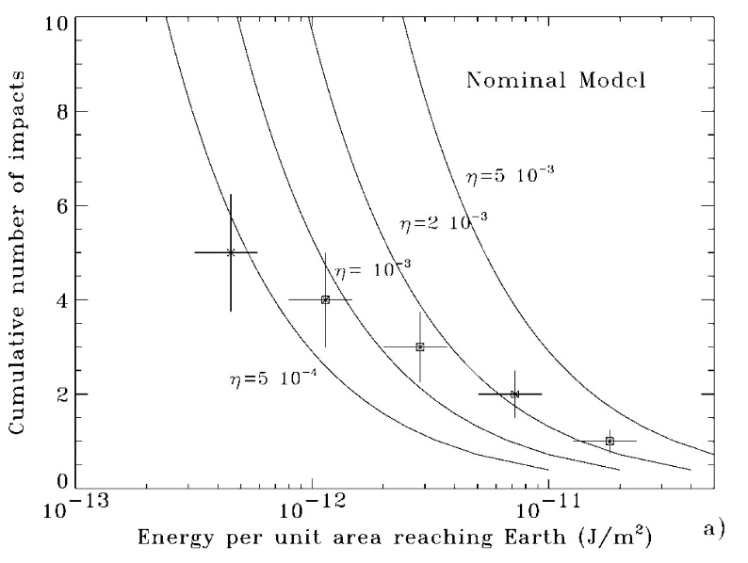
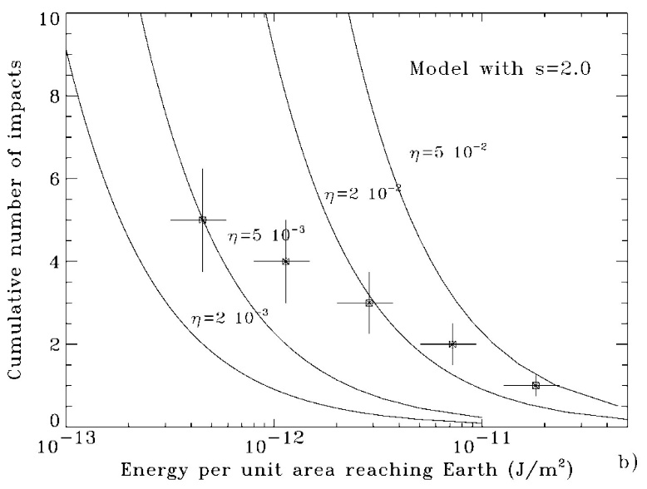
Kinetic Energy and Radiated Energy
$$E_{K}=E_{r}/η$$
Kinetic energy: $E_{K}$
Luminous efficiency : $η$
Radiated energy: $E_{r}$
Gözlenen çarpma sayısı: $N$
Kütlesi $m_{0}$’dan büyük Ay’daki göktaşı miktarı: $F(m_{0})$
Gözlem süresi: $Δt$
Yer’den gözlenen enerji: $E_{d}$
Kütle indeksi: $s$
Ay yüzeyinde gözlenen alan: $A$
(Bellot-Rubio et al., 2000)

Slide 17
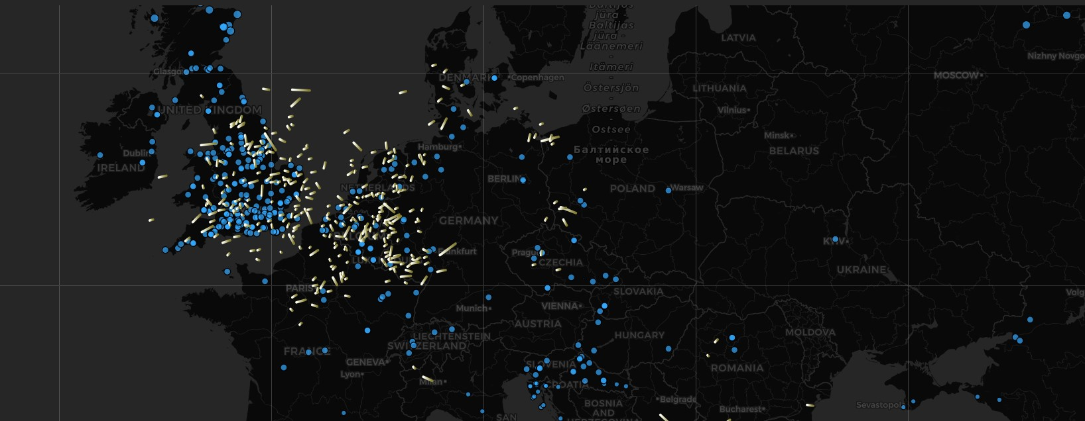
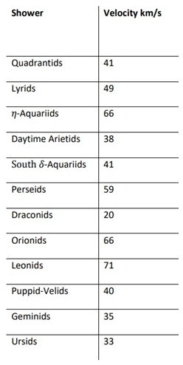
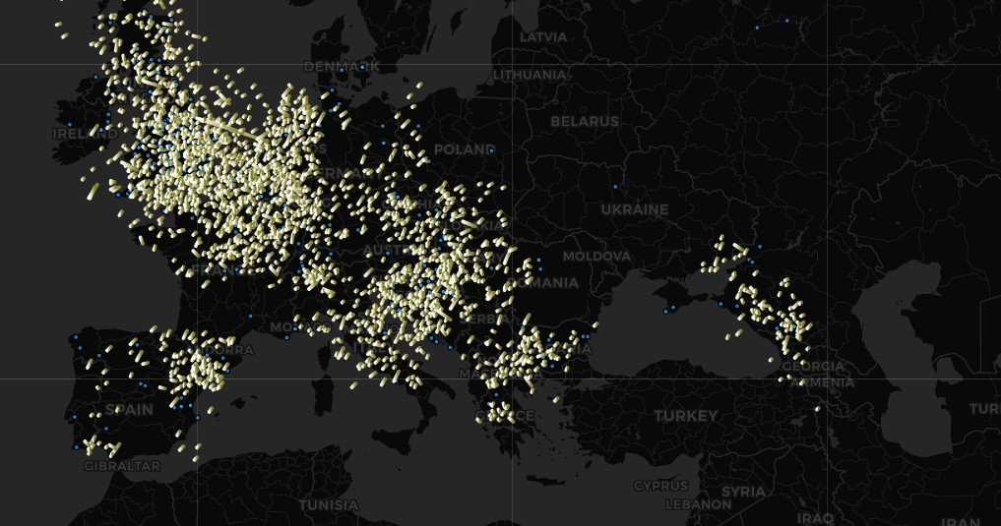
Velocity and Mass
$$E_{K}=E_{r}/η$$
$$E_{K} = \frac{1}{2}mV^{2}$$
Mass: $m$
Velocity: $V$
(https://tammojan.github.io/meteormap/)

Slide 18
Probability Parameter
(Madiedo et al., 2015a)

Slide 19
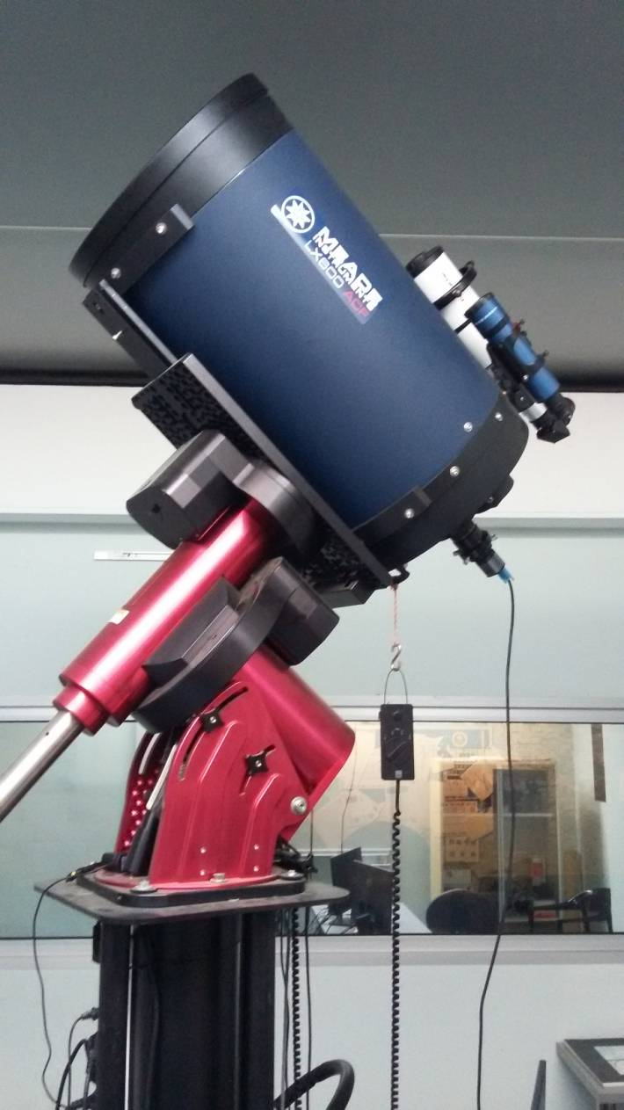
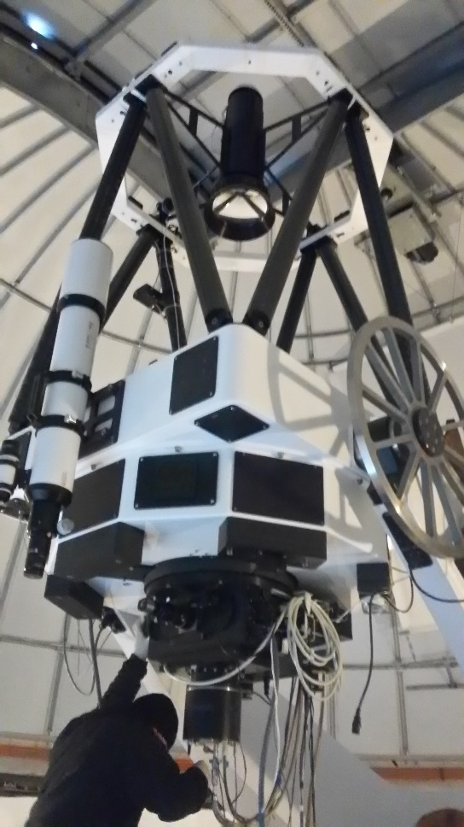
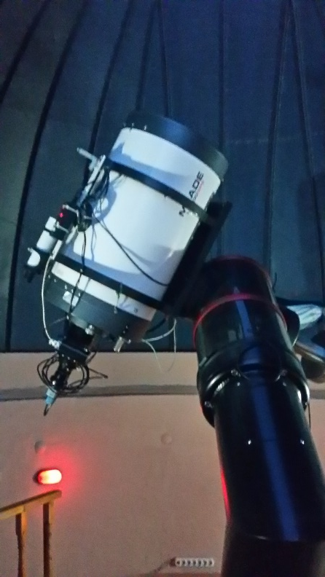
Observations in Turkey (2016-2024)
İSTEK Belde Observatory
Meade LX600 16’’ f/8, Celestron Skyriss 274M
Ege University Observatory
Meade LX 200 GPS 16’’ , QHY5III M camera
TÜBİTAK National Observatory (TUG)
ACE RC1.0 Ritchey-Chretien 100cm

Slide 20
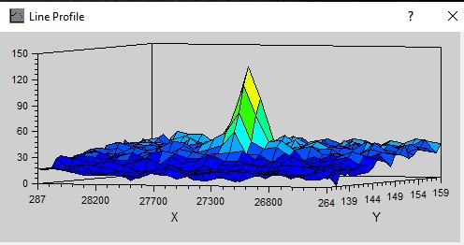
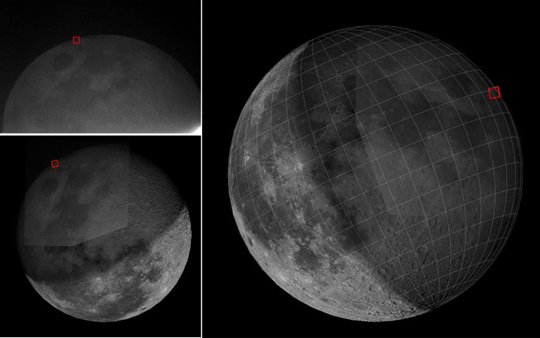
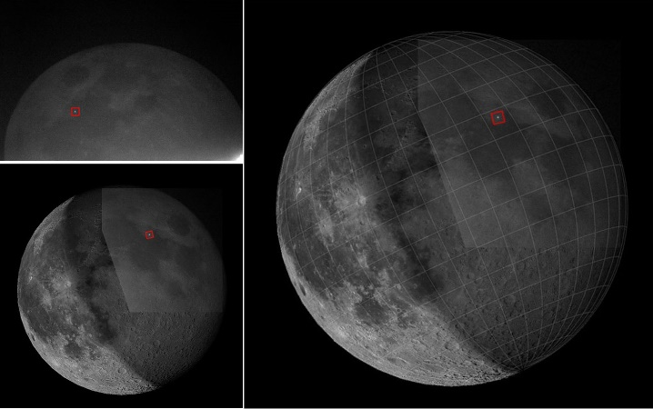
12 December 2017
04:19:30.866 (UT)
Longitude 82.9 E
Latitude 8.3 N
04:20:04.400 (UT)
Longitude 33.8 E
Latitude 16.4 N
$E_{r(1)}=1.96x{10}^{6}$ J
$t_{1}=0.533$s
$$E_{r(2)}=2.33x{10}^{6} \text{J}$$
$t_{2}=0.466$ s
$$m_{1}=7.97$$
$$m_{2}=7.48$$

Slide 21
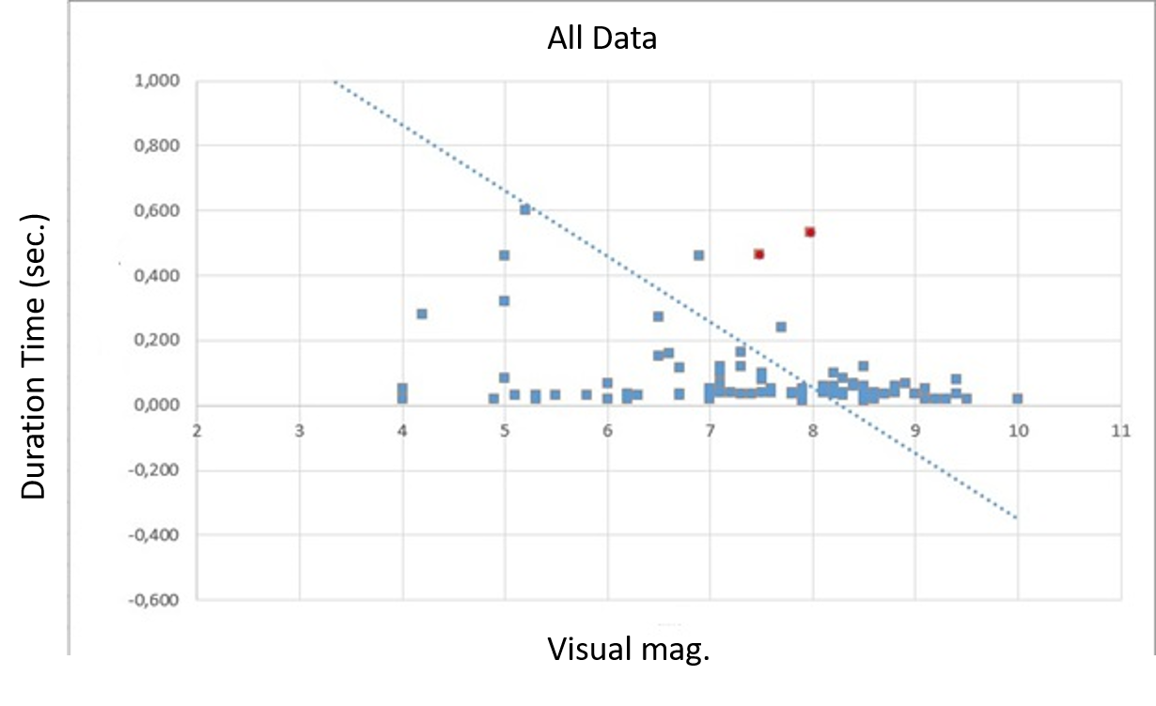
Comparison Visual Mag - Dur. Time
All Data

Slide 22
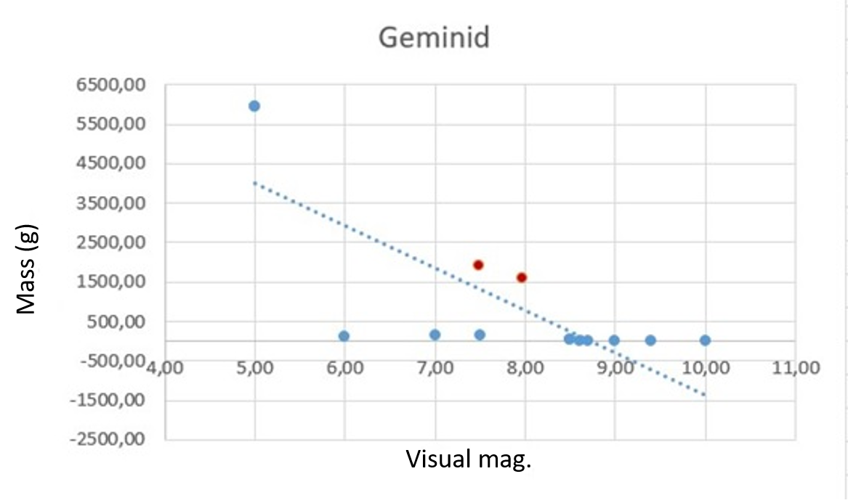
Results
$$E_{K}=E_{r}/η$$
$η$= $2x{10}^{−3}$
$E_{K(1)}=9,8x{10}^{8}$ J $E_{K(2)}=1,17x{10}^{9}$ J
Probability of Geminids;
$$V_{Gem}=35 km/s$$
$$M_{1}=1,6 kg$$
$$M_{2}=1,9 kg$$

Slide 23
Thank You…

